Slide 1
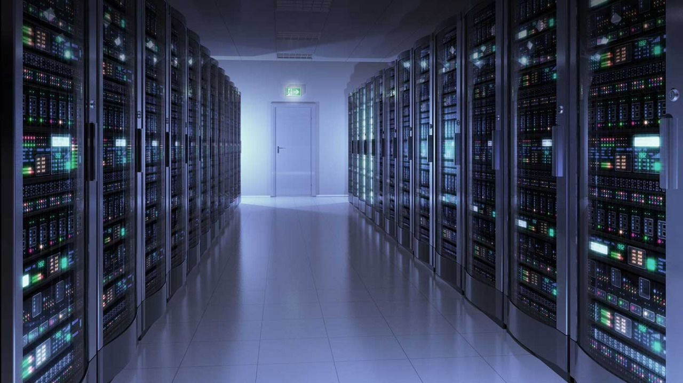

GPU Programming (in CUDA)
Spring 2019
Julian Gutierrez
Session 9

Slide 2
Outline
Image Processing
Final Project

Slide 3
Why Do We Process Images?
Enhancement and restoration
Remove artifacts and scratches from an old photo/movie
Improve contrast and correct blurred images
Transmission and storage
Images and Video can be more effectively transmitted and stored
Information analysis and automated recognition
Recognizing terrorists
Evidence
Careful image manipulation can reveal information not present
Detect image tampering
Security and rights protection
Encryption and watermarking preventing illegal content manipulation
Notes:
Image carry a lot of information (A picture is worth a thousand words)

Slide 4
Examples

Slide 5
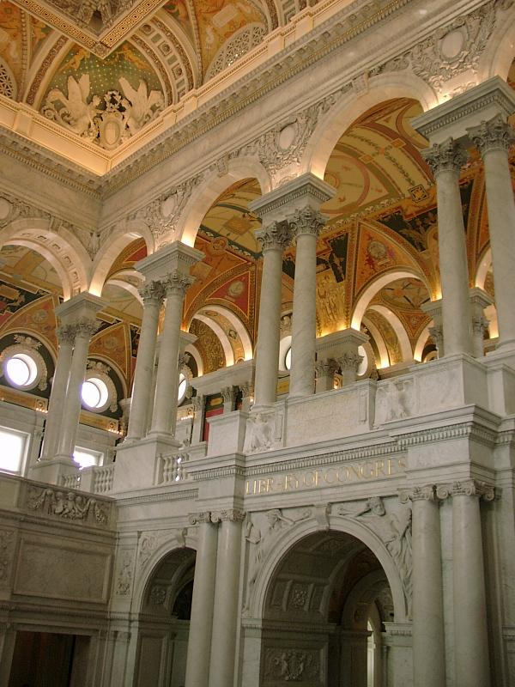
Compression
Color image of 600x800 pixels
Without compression
600*800 * 24 bits/pixel = 11 520K bits = 1.44M bytes
After JPEG compression (popularly used on web)
only 89K bytes
compression ratio ~ 16:1
Movie
720x480 per frame, 30 frames/sec, 24 bits/pixel
Raw video ~ 243M bits/sec
DVD ~ about 5M bits/sec
Compression ratio ~ 48:1
“Library of Congress” by M.Wu (600x800)

Slide 6
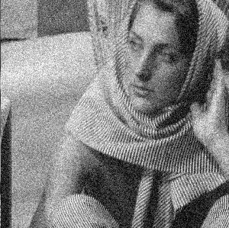
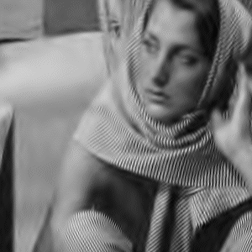
Denoising
From X.Li http://www.ee.princeton.edu/~lixin/denoising.htm

Slide 7
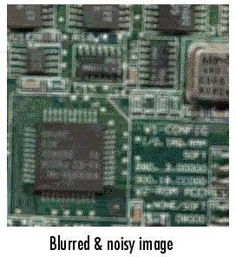
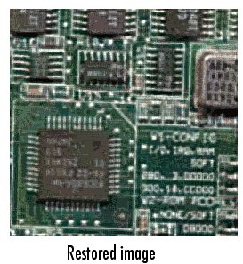
Deblurring
From Mathworks

Slide 8
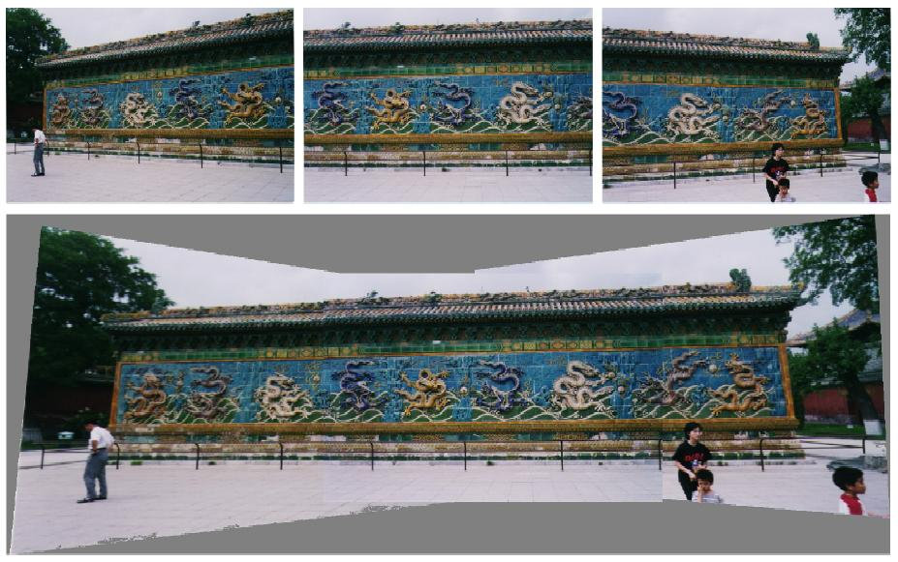
Visual Mosaicing
Stitch photos together without thread or scotch tape
R.Radke – IEEE PRMI journal paper draft 5/01

Slide 9
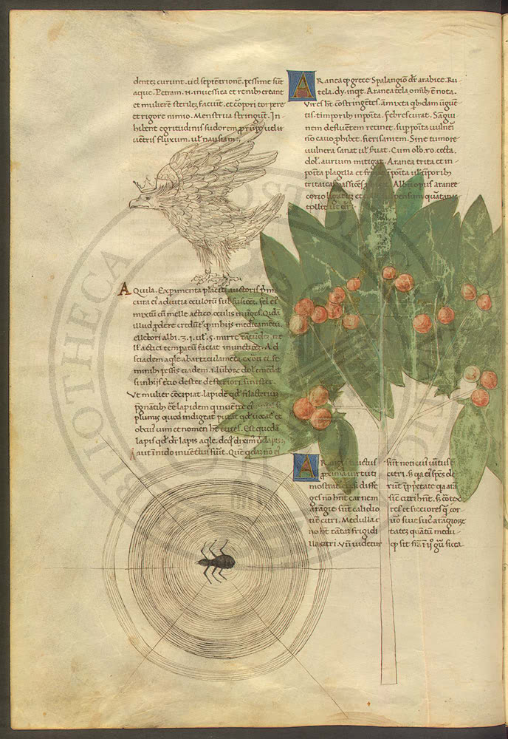
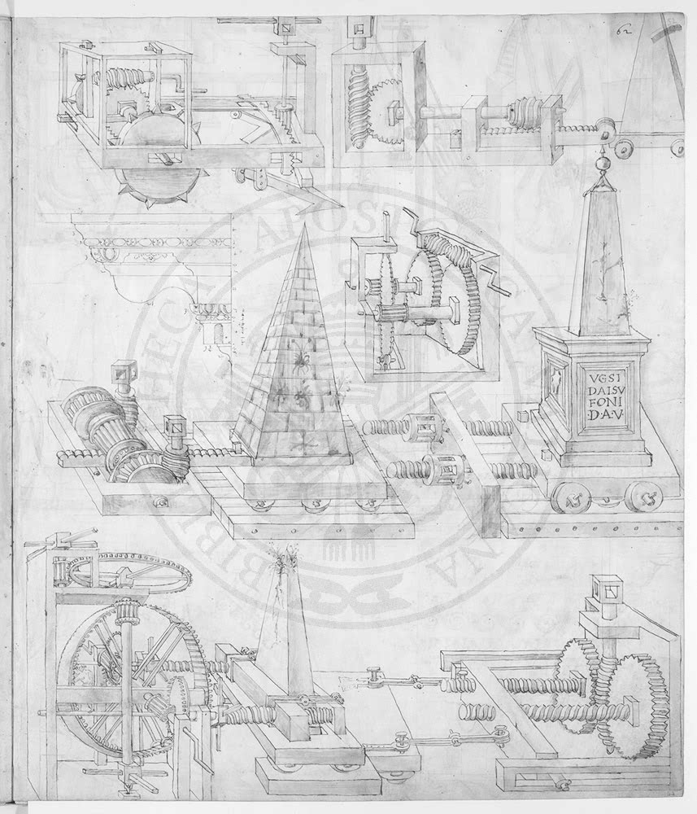
Visible Digital Watermarks
from IBM Watson web page “Vatican Digital Library”

Slide 10
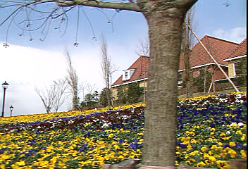

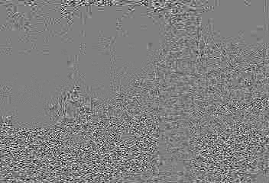
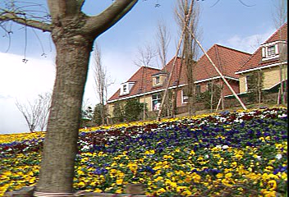

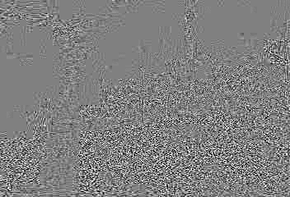
Invisible Watermark
1st & 30th Mpeg4.5Mbps frame of original, marked, and their luminance difference
human visual model for imperceptibility: protect smooth areas and sharp edges

Slide 11
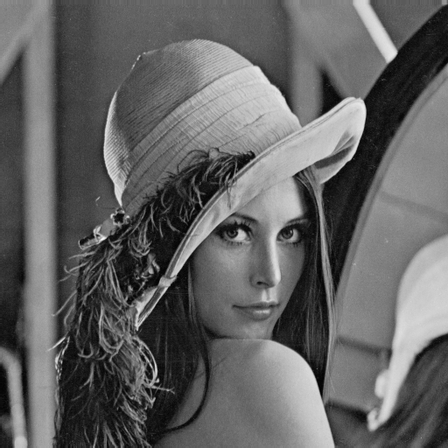
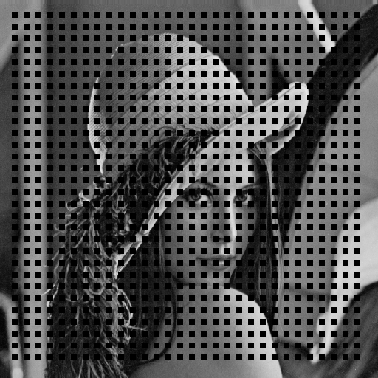

Error Concealment
(a) original Lenna image
(b) corrupted Lenna image
(c) concealed Lenna image
25% blocks in a checkerboard pattern are corrupted
corrupted blocks are concealed via edge-directed interpolation
Examples were generated using the source codes provided by W.Zeng.

Slide 12
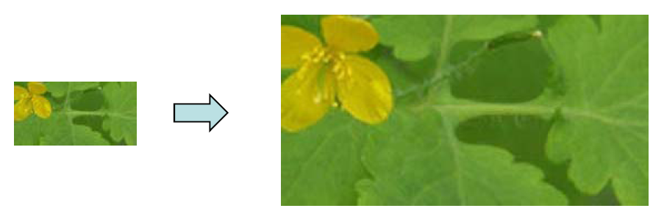
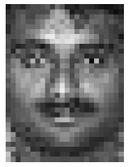
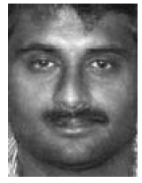

Image Super-Resolution
Super-Resolution(SR)
Low resolution images High resolution images
Face Hallucination
Super-resolution on human faces
Courtesy of Jianchao Yang

Slide 13
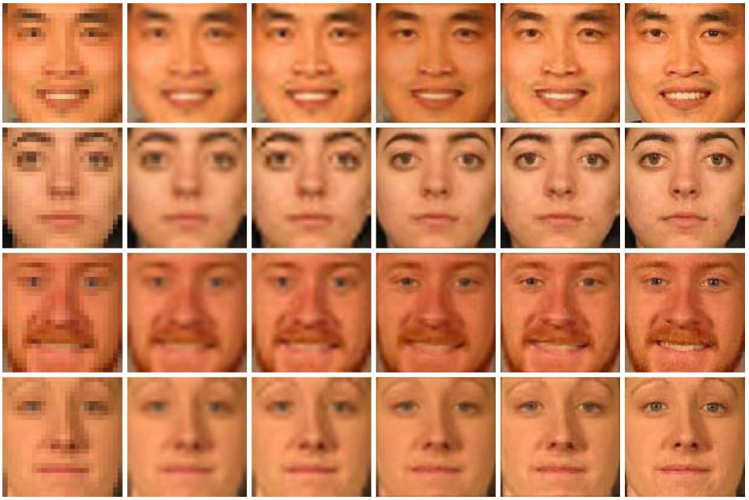
Face Hallucination
Input image
Bicubic interpolation
Back projection
NMF
Sparse Coding
Original
Courtesy of Jianchao Yang

Slide 14
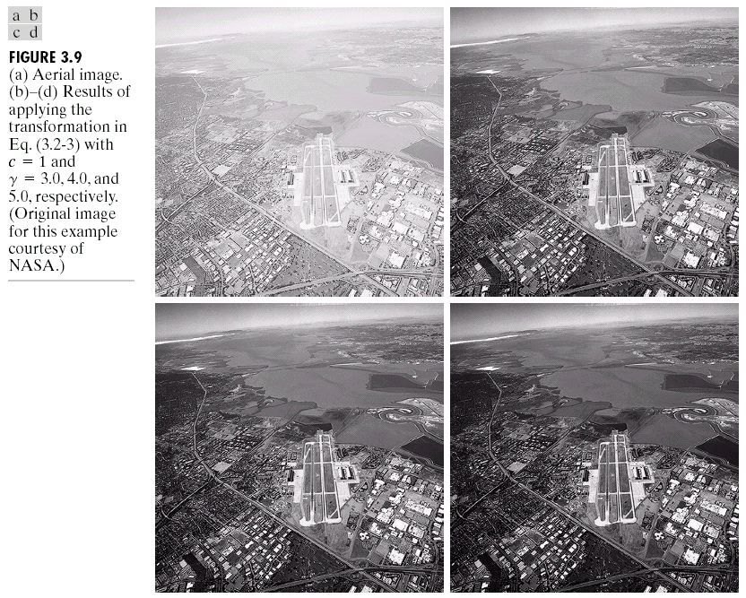
Image Enhancement

Slide 15
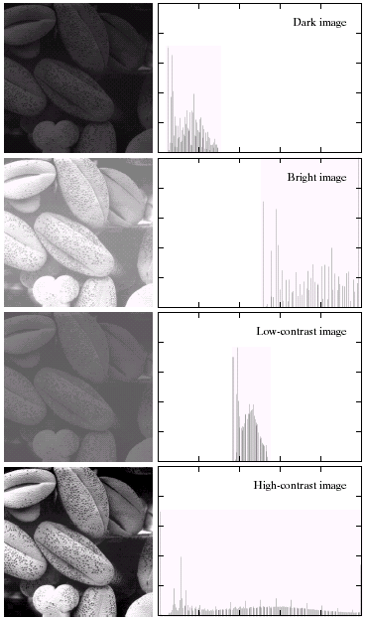
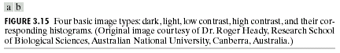
Image Histograms

Slide 16
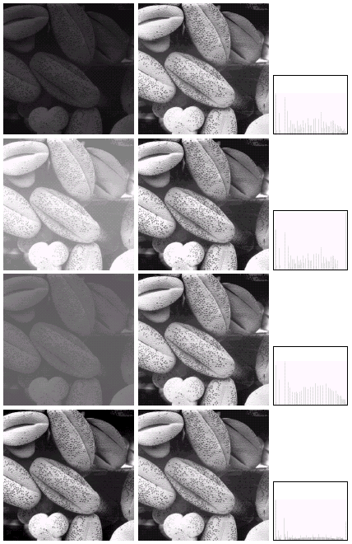
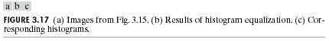
Histogram Equalization

Slide 17
What is an Image?

Slide 18
What is an image?
We can think of an image as a function, f:
f( x, y ) gives the intensity at position ( x, y )
Realistically, we expect the image only to be defined over a rectangle, with a finite range:
f: [a,b]x[c,d] → [0,1]
A color image is just three functions pasted together. We can write this as a “vector-valued” function
Notes:
As opposed to [0..255]

Slide 19
Images as functions
Notes:
Render with scanalyze????

Slide 20
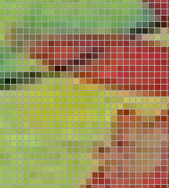
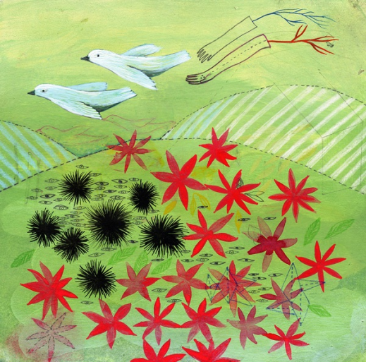
Digital Image
In digital imaging, a pixel (picture element) is the smallest piece of information in an image.
The word pixel is based on a contraction of pix (for "pictures") and el (for "element")
Each pixel is a sample of an original image, where more samples typically provide a more accurate representation of the original.
The intensity of each pixel is variable; in color systems, each pixel has typically three or four components such as red, green, and blue, or cyan, magenta, yellow, and black.
http://en.wikipedia.org/wiki/Pixel
Google.com image search

Slide 21

What is a digital image?
We usually operate on digital (discrete) images:
Sample the 2D space on a regular grid
Quantize each sample (round to nearest integer)
The image can now be represented as a matrix of integer values

Slide 22
How can we read images?

Slide 23
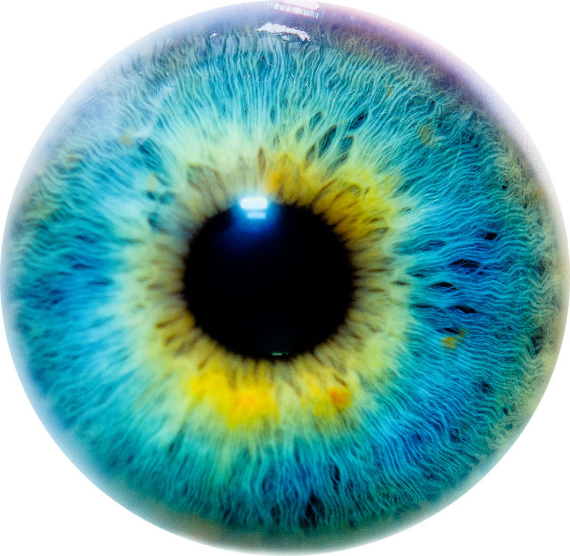
Image file Formats
Image file formats are standardized means of organizing and storing digital images.
Types of files
JPEG
PNG
BMP
GIF
PPM
PGM
Etc

Slide 24
How can we read these formats
So many different formats, which one is the best one?
Which one is the easiest to interpret?
The answer to these questions is not easy.
Best way to read these types of files is through libraries such as Cimg, libjpeg, OpenCV.

Slide 25

Simplest version
portable pixmap format (PPM), the portable graymap format (PGM)
These formats don’t use any sort of compression so they are big files but easy to read the data.
P2
# Shows the word "FEEP" (example from Netpbm man page on PGM)
24 7
15
0 0 0 0 0 0 0 0 0 0 0 0 0 0 0 0 0 0 0 0 0 0 0 0
0 3 3 3 3 0 0 7 7 7 7 0 0 11 11 11 11 0 0 15 15 15 15 0
0 3 0 0 0 0 0 7 0 0 0 0 0 11 0 0 0 0 0 15 0 0 15 0
0 3 3 3 0 0 0 7 7 7 0 0 0 11 11 11 0 0 0 15 15 15 15 0
0 3 0 0 0 0 0 7 0 0 0 0 0 11 0 0 0 0 0 15 0 0 0 0
0 3 0 0 0 0 0 7 7 7 7 0 0 11 11 11 11 0 0 15 0 0 0 0
0 0 0 0 0 0 0 0 0 0 0 0 0 0 0 0 0 0 0 0 0 0 0 0

Slide 26
Simplest version
In this PGM example
P2 means PGM
The next two numbers give the width and the height.
The next number represents the maximum value (numbers of grey between black and white)
Black is 0 and max value is white.
Then follows the matrix with the pixel values.
The PGM and PPM formats (both ASCII and binary versions)
P2
# Shows the word "FEEP" (example from Netpbm man page on PGM)
24 7
15
0 0 0 0 0 0 0 0 0 0 0 0 0 0 0 0 0 0 0 0 0 0 0 0
0 3 3 3 3 0 0 7 7 7 7 0 0 11 11 11 11 0 0 15 15 15 15 0
0 3 0 0 0 0 0 7 0 0 0 0 0 11 0 0 0 0 0 15 0 0 15 0
0 3 3 3 0 0 0 7 7 7 0 0 0 11 11 11 0 0 0 15 15 15 15 0
0 3 0 0 0 0 0 7 0 0 0 0 0 11 0 0 0 0 0 15 0 0 0 0
0 3 0 0 0 0 0 7 7 7 7 0 0 11 11 11 11 0 0 15 0 0 0 0
0 0 0 0 0 0 0 0 0 0 0 0 0 0 0 0 0 0 0 0 0 0 0 0

Slide 27
Code Examples

Slide 28
Simple algorithm
Brightness
Increase/Decrease the intensity of the pixels by a specific value
Lets look at the code

Slide 29
What is the Makefile?
Makefile’s are a simple way to organize code compilation.
A Makefile is a file containing a set of directives used with the make build automation tool from GNU.
Incredibly useful when your project becomes bigger and bigger.
# environment
SM := 35
GCC := g++
NVCC := nvcc
# Remove function
RM = rm -f
# Specify opencv Installation
opencvLIB= -L/shared/apps/opencv-3.0.0-beta/INSTALL/lib
opencvINC= -I/shared/apps/opencv-3.0.0-beta/INSTALL/include
# Compiler flags:
# -g debugging information
# -Wall turns on most compiler warnings
GENCODE_FLAGS := -gencode arch=compute_$(SM),code=sm_$(SM)
LIB_FLAGS := -lcudadevrt -lcudart
NVCCFLAGS :=
GccFLAGS = -fopenmp -O3
OPENCV_LINK = -lopencv_core -lopencv_highgui -lopencv_imgproc -lopencv_photo -lopencv_video -lopencv_imgcodecs
debug: GccFLAGS += -DDEBUG -g -Wall
debug: NVCCFLAGS += -g -G
debug: all
# The build target executable:
TARGET = brightness
all: build
build: $(TARGET)
$(TARGET): src/dlink.o src/main.o src/$(TARGET).o
$(NVCC) $(NVCCFLAGS) $(opencvLIB) $(opencvINC) $^ -o $@ $(GENCODE_FLAGS) $(OPENCV_LINK) -link
src/dlink.o: src/$(TARGET).o
$(NVCC) $(NVCCFLAGS) $^ -o $@ $(GENCODE_FLAGS) -dlink
src/main.o: src/main.cpp
$(GCC) $(GccFLAGS) $(opencvLIB) $(opencvINC) -c $< -o $@
src/$(TARGET).o: src/$(TARGET).cu
$(NVCC) $(NVCCFLAGS) -dc $< -o $@ $(GENCODE_FLAGS)
clean:
$(RM) $(TARGET) src/*.o *.o *.tar* *.core* *out*.jpg *input*.jpg

Slide 30
int main( int argc, const char** argv ) {
double start_cpu, finish_cpu;
double start_gpu, finish_gpu;
// Read input image from argument
Mat input_image = imread(argv[1], IMREAD_COLOR);
int inc = atoi(argv[2]);
// Convert the color image to grayscale image
cvtColor(input_image, input_image, COLOR_BGR2GRAY);
unsigned int height = input_image.rows;
unsigned int width = input_image.cols;
// Construct padded image
Mat padded;
int gridXSize = 1 + (( width - 1) / TILE_SIZE);
int gridYSize = 1 + ((height - 1) / TILE_SIZE);
int XSize = gridXSize*TILE_SIZE;
int YSize = gridYSize*TILE_SIZE;
padded.create(YSize, XSize, input_image.type());
padded.setTo(cv::Scalar::all(0));
input_image.copyTo(padded(Rect(0, 0, input_image.cols, input_image.rows)));
// START CPU Processing
start_cpu = CLOCK();
Mat cpu_output;
padded.convertTo(cpu_output, -1, 1, inc);
finish_cpu = CLOCK();
// START GPU Processing
start_gpu = CLOCK();
Mat gpu_output = padded.clone();
gpu_function((unsigned char *) gpu_output.data,
height,
width,
inc);
finish_gpu = CLOCK();
// Calculate % difference between GPU and CPU
unsigned int wrong_pixels = 0;
for(unsigned int j = 0; j < height; j++){
for(unsigned int i = 0; i < width; i++){
unsigned char cpu_pixel = cpu_output.data[width * j + i ];
unsigned char gpu_pixel = gpu_output.data[width * j + i ];
if (abs(cpu_pixel - gpu_pixel) > 0)
wrong_pixels++;
}
}
cout << "CPU execution time: " << finish_cpu - start_cpu << " ms" << endl;
cout << "GPU execution time: " << finish_gpu - start_gpu << " ms" << endl;
cout << "Percentage difference: " << wrong_pixels*100.0/(height*width) << " %\n";
imwrite ("input.jpg", input_image);
cv::Mat subImg1 = cpu_output(cv::Range(0, input_image.rows), cv::Range(0, input_image.cols));
imwrite ("output_cpu.jpg", subImg1);
cv::Mat subImg2 = gpu_output(cv::Range(0, input_image.rows), cv::Range(0, input_image.cols));
imwrite ("output_gpu.jpg", subImg2);
return 0;
}

Slide 31
void gpu_function (unsigned char *data,
unsigned int height,
unsigned int width,
int inc ){
int gridXSize = 1 + (( width - 1) / TILE_SIZE);
int gridYSize = 1 + ((height - 1) / TILE_SIZE);
int XSize = gridXSize*TILE_SIZE;
int YSize = gridYSize*TILE_SIZE;
// Both are the same size (CPU/GPU).
int size = XSize*YSize;
// Allocate arrays in GPU memory
checkCuda(cudaMalloc((void**)&input_gpu , size*sizeof(unsigned char)));
checkCuda(cudaMalloc((void**)&output_gpu , size*sizeof(unsigned char)));
checkCuda(cudaMemset(output_gpu , 0 , size*sizeof(unsigned char)));
// Copy data to GPU
checkCuda(cudaMemcpy(input_gpu,
data,
size*sizeof(char),
cudaMemcpyHostToDevice));
checkCuda(cudaDeviceSynchronize());
// Execute algorithm
dim3 dimGrid(gridXSize, gridYSize);
dim3 dimBlock(TILE_SIZE, TILE_SIZE);
// Kernel Call
#if defined(CUDA_TIMING)
float Ktime;
TIMER_CREATE(Ktime);
TIMER_START(Ktime);
#endif
kernel<<<dimGrid, dimBlock>>>(input_gpu,
output_gpu,
inc);
checkCuda(cudaPeekAtLastError());
checkCuda(cudaDeviceSynchronize());
#if defined(CUDA_TIMING)
TIMER_END(Ktime);
printf("Kernel Execution Time: %f ms\n", Ktime);
#endif
// Retrieve results from the GPU
checkCuda(cudaMemcpy(data,
output_gpu,
size*sizeof(unsigned char),
cudaMemcpyDeviceToHost));
// Free resources and end the program
checkCuda(cudaFree(output_gpu));
checkCuda(cudaFree(input_gpu));
}

Slide 32
__global__ void kernel(unsigned char *input,
unsigned char *output,
int inc){
// Read Input Data
////////////////////////////////////////////////////
int x = blockIdx.x*TILE_SIZE+threadIdx.x;
int y = blockIdx.y*TILE_SIZE+threadIdx.y;
int location = y*(gridDim.x*TILE_SIZE)+x;
unsigned char value = input[location];
// Algorithm
////////////////////////////////////////////////////
if ((int) value + inc > 255) value = 255;
else if ((int) value + inc < 0) value = 0;
else value = value + inc;
output[location] = value;
}

Slide 33
How can we improve brightness?
Shared memory?
Constant Memory?
Texture memory?
More processing per thread
Adding more work to each thread
Bring in more data on each read
Notes:
Not really right

Slide 34
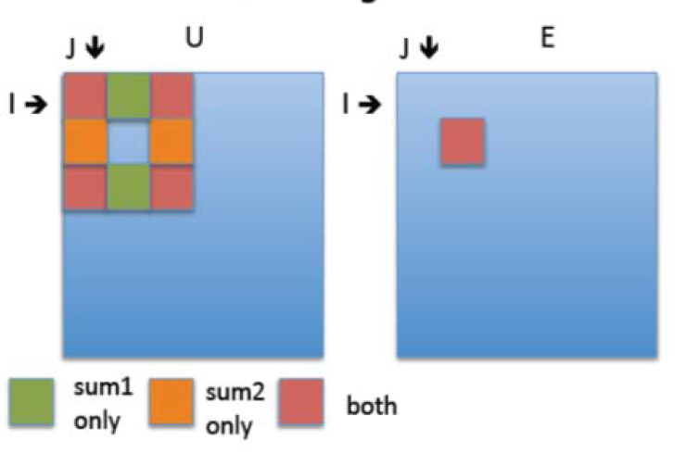
A more complex example
Sobel algorithm
Sobel edge detection
Find the boundaries of the image where there is significant difference as compared to neighboring “pixels” and replace values to find edges.

Slide 35
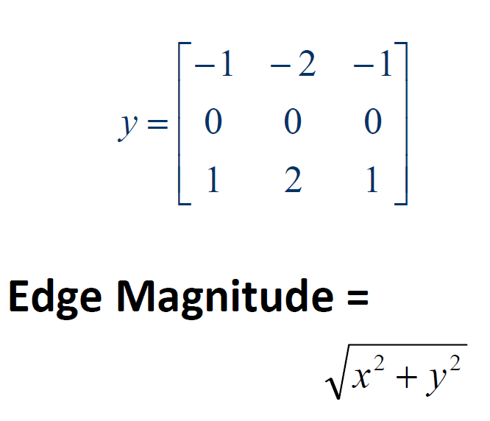
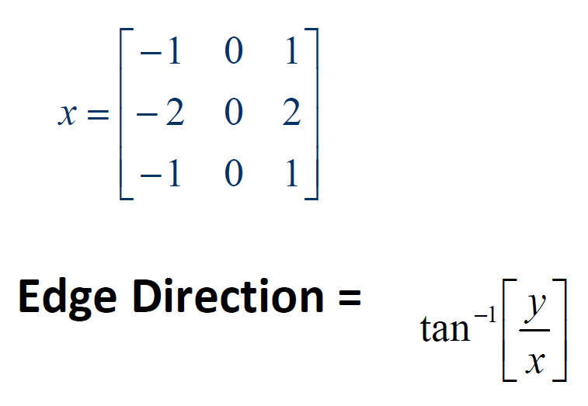
Sobel Algorithm
Looks for edges in both horizontal and vertical directions, then combine the information into a single metric.
The masks are:

Slide 36
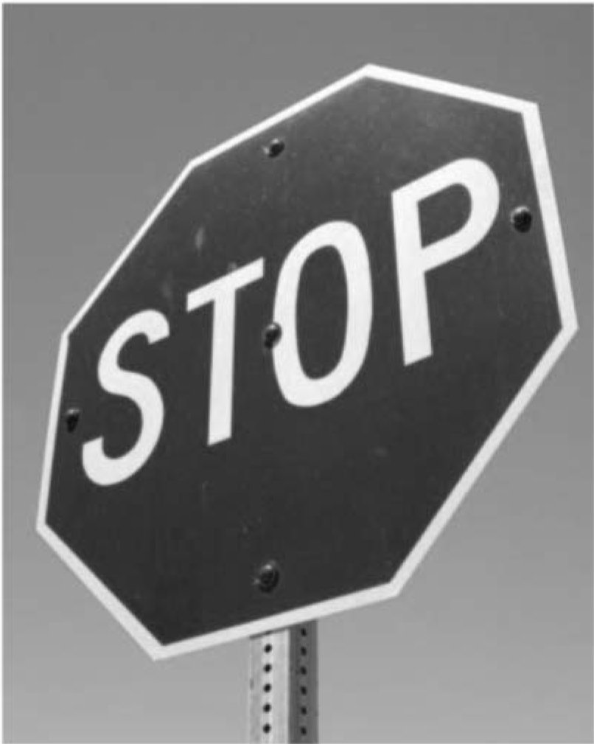

Sobel Algorithm
Output
Input

Slide 37
int main( int argc, const char** argv ) {
double start_cpu, finish_cpu;
double start_gpu, finish_gpu;
int threshold = atoi(argv[2]);
// Convert the color image to grayscale image
cvtColor(input_image, input_image, COLOR_BGR2GRAY);
unsigned int height = input_image.rows;
unsigned int width = input_image.cols;
// Construct padded image
Mat padded;
int gridXSize = 1 + (( width - 1) / TILE_SIZE);
int gridYSize = 1 + ((height - 1) / TILE_SIZE);
int XSize = gridXSize*TILE_SIZE;
int YSize = gridYSize*TILE_SIZE;
padded.create(YSize, XSize, input_image.type());
padded.setTo(cv::Scalar::all(0));
input_image.copyTo(padded(Rect(0, 0, input_image.cols, input_image.rows)));
// START CPU Processing
Mat cpu_output = padded.clone();
for(unsigned int y = 0 ; y < height ; y++) {
for(unsigned int x = 0 ; x < width ; x++) {
if (y >= 1 && y < height - 1 && x >= 1 && x < width - 1){
// Algorithm
///////////////////////////////////////////////////
int sum1 = padded.at<uchar>(y-1, x+1) -
padded.at<uchar>(y-1, x-1) +
2 * padded.at<uchar>(y , x+1) -
2 * padded.at<uchar>(y , x-1) +
padded.at<uchar>(y+1, x+1) -
padded.at<uchar>(y+1, x-1);
int sum2 = padded.at<uchar>(y-1, x-1) +
2 * padded.at<uchar>(y-1, x ) +
padded.at<uchar>(y-1, x+1) -
padded.at<uchar>(y+1, x-1) -
2 * padded.at<uchar>(y+1, x ) -
padded.at<uchar>(y+1, x+1);
int magnitude = sqrt( (float) (sum1*sum1 + sum2*sum2));
if (magnitude > threshold)
cpu_output.at<uchar>(y, x) = 255;
else
cpu_output.at<uchar>(y, x) = 0;
} else
cpu_output.at<uchar>(y, x) = 0;
}
}
Mat gpu_output = padded.clone();
gpu_function((unsigned char *) gpu_output.data,
height,
width,
threshold);
finish_gpu = CLOCK();
// Calculate % difference between GPU and CPU
…
return 0;
}

Slide 38
void gpu_function (unsigned char *data,
unsigned int height,
unsigned int width,
int threshold ){
int gridXSize = 1 + (( width - 1) / TILE_SIZE);
int gridYSize = 1 + ((height - 1) / TILE_SIZE);
int XSize = gridXSize*TILE_SIZE;
int YSize = gridYSize*TILE_SIZE;
// Both are the same size (CPU/GPU).
int size = XSize*YSize;
// Allocate arrays in GPU memory
checkCuda(cudaMalloc((void**)&input_gpu , size*sizeof(unsigned char)));
checkCuda(cudaMalloc((void**)&output_gpu , size*sizeof(unsigned char)));
checkCuda(cudaMemset(output_gpu , 0 , size*sizeof(unsigned char)));
// Copy data to GPU
checkCuda(cudaMemcpy(input_gpu,
data,
size*sizeof(char),
cudaMemcpyHostToDevice));
checkCuda(cudaDeviceSynchronize());
// Execute algorithm
dim3 dimGrid(gridXSize, gridYSize);
dim3 dimBlock(TILE_SIZE, TILE_SIZE);
// Kernel Call
#if defined(CUDA_TIMING)
float Ktime;
TIMER_CREATE(Ktime);
TIMER_START(Ktime);
#endif
kernel<<<dimGrid, dimBlock>>>(input_gpu,
output_gpu,
width,
height,
threshold);
checkCuda(cudaPeekAtLastError());
checkCuda(cudaDeviceSynchronize());
#if defined(CUDA_TIMING)
TIMER_END(Ktime);
printf("Kernel Execution Time: %f ms\n", Ktime);
#endif
// Retrieve results from the GPU
checkCuda(cudaMemcpy(data,
output_gpu,
size*sizeof(unsigned char),
cudaMemcpyDeviceToHost));
// Free resources and end the program
checkCuda(cudaFree(output_gpu));
checkCuda(cudaFree(input_gpu));
}

Slide 39
__global__ void kernel(unsigned char *input,
unsigned char *output,
unsigned int size_x,
unsigned int size_y,
int threshold){
// Read Input Data
////////////////////////////////////////////////////////////
unsigned int x = blockIdx.x*TILE_SIZE+threadIdx.x;
unsigned int y = blockIdx.y*TILE_SIZE+threadIdx.y;
unsigned int location = y*(gridDim.x*TILE_SIZE)+x;
// If thread out of image range, exit
if (y >= 1 && y < size_y - 1 && x >= 1 && x < size_x - 1){
// Algorithm
////////////////////////////////////////////////////////
int sum1 = input[ (gridDim.x*TILE_SIZE) * (y-1) + x+1 ] -
input[ (gridDim.x*TILE_SIZE) * (y-1) + x-1 ] +
2 * input[ (gridDim.x*TILE_SIZE) * (y) + x+1 ] -
2 * input[ (gridDim.x*TILE_SIZE) * (y) + x-1 ] +
input[ (gridDim.x*TILE_SIZE) * (y+1) + x+1 ] -
input[ (gridDim.x*TILE_SIZE) * (y+1) + x-1 ];
int sum2 = input[ (gridDim.x*TILE_SIZE) * (y-1) + x-1 ] +
2 * input[ (gridDim.x*TILE_SIZE) * (y-1) + x ] +
input[ (gridDim.x*TILE_SIZE) * (y-1) + x+1 ] -
input[ (gridDim.x*TILE_SIZE) * (y+1) + x-1 ] -
2 * input[ (gridDim.x*TILE_SIZE) * (y+1) + x ] -
input[ (gridDim.x*TILE_SIZE) * (y+1) + x+1 ];
int magnitude = sqrt( (float) (sum1*sum1 + sum2*sum2));
if (magnitude > threshold)
output[location] = 255;
else
output[location] = 0;
}
}

Slide 40
Final Project
Open File

Slide 41
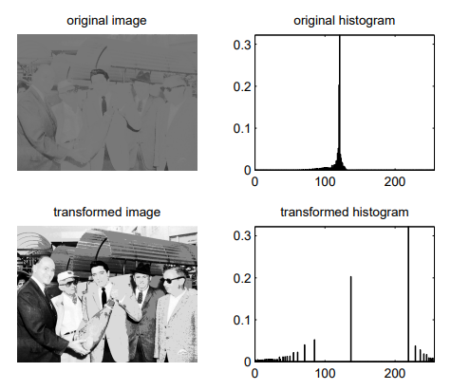
Histogram Equalization
Basics
Image histogram equalization is an algorithm commonly used to preprocess images to enhance the contrast of the image by trying it’s best to “normalize the histogram” of the image.
Example:

Slide 42
Histogram Equalization
Algorithm:
Calculate histogram of the image
Calculate PMF of image (histogram / total # pixels)
Calculate the CDF (cumulative distributive function) (Prefix Sum)
Calculate the CDF * 255 to obtain the new gray level values
Use the old gray value and map it into the CDF * 255 array to obtain the new gray level value of the pixel

Slide 43
Possible Optimizations
Use shared memory
Optimize the histogram using local histograms and then updating globally
Process multiple pixels per thread
Use texture memory
Incorporate pinned memory (covered next week)
Use streams for more parallelization (covered next week)
Etc

Slide 44
Histogram Equalization
I will send out an email with the date and time for the final class where you will be presenting your work.
We will have the class after spring break.
For more information on histogram equalization:
http://www.tutorialspoint.com/dip/Histogram_Equalization.htm
https://www.math.uci.edu/icamp/courses/math77c/demos/hist_eq.pdf

